Slide 1
Inventory Management System
Submitted by
Manoj Gangavarapu
Lakshmi Chandra Pothinindi
Bharghav Thanniru
Jagadish Reddy Kandula CPSC : 449

Slide 2
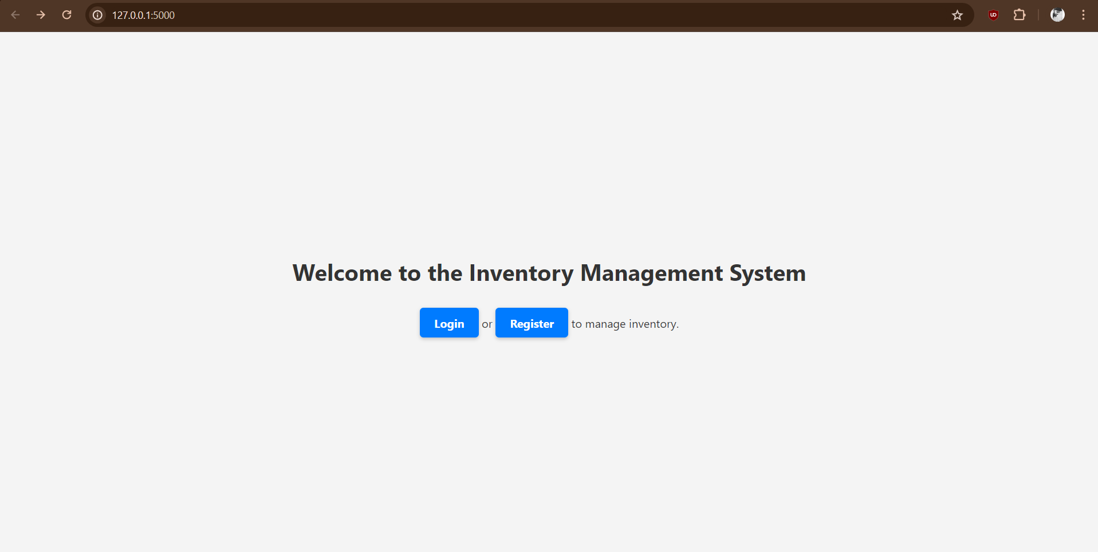
Main Page

Slide 3
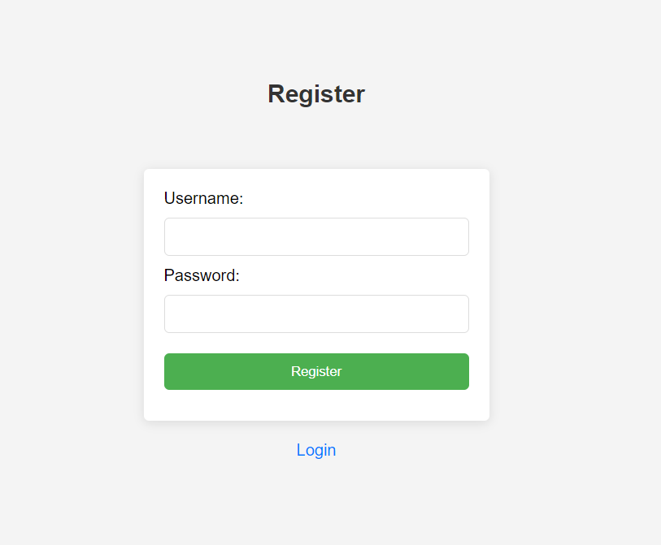
Registration Page
Register using username and password

Slide 4
Password encryption
import bcrypt
Bcrypt is a password hashing function that stores passwords in a way that is less vulnerable to dictionary-based cyberattacks.
hashed = bcrypt.hashpw(password.encode('utf-8'), bcrypt.gensalt())

Slide 5
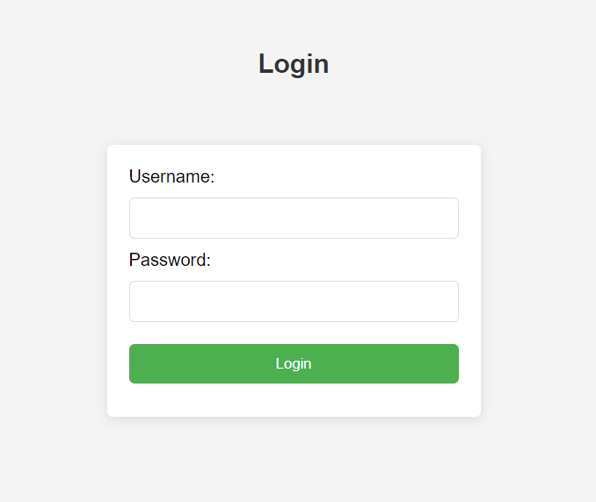
Login
Login using the registered username and password.

Slide 6
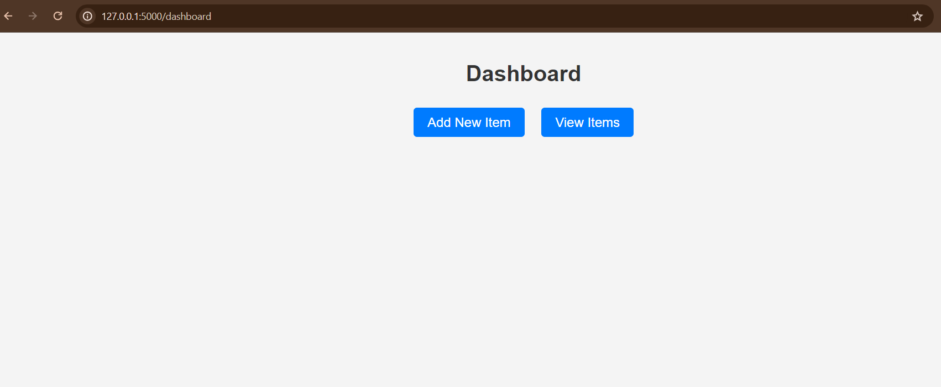
Dashboard
Dashboard has an option to add new items and view existing items.

Slide 7
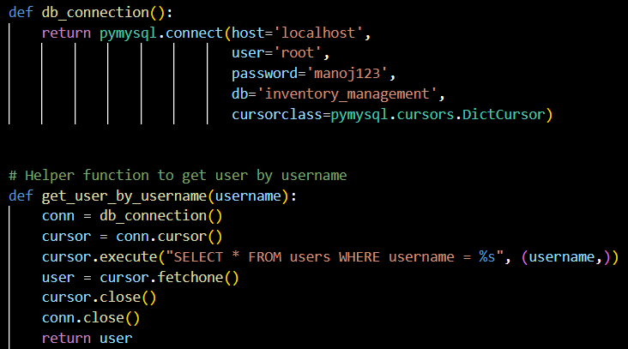

Database
MySQL

Slide 8
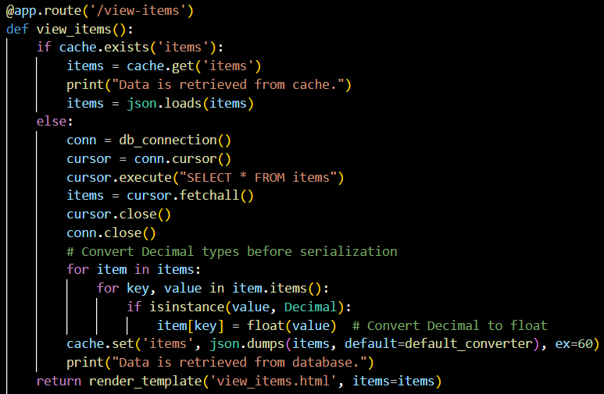

Caching
Used cache in the view items. Once the details are fetched, they stay in the cache for 60 seconds.

Slide 9

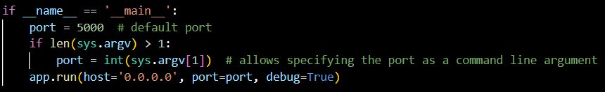
Load Balancer

Slide 10
Nginx
In our project, we discussed using Nginx primarily as a load balancer to distribute incoming network traffic across multiple instances of our Flask application.
Nginx as a Load Balancer
Configuration: Nginx was configured as a load balancer with an upstream block in its configuration file, defining multiple Flask instances as servers to distribute incoming requests efficiently.
Proxy Settings: Nginx's server block was configured to listen on a common port (typically port 80) and used the proxy_pass directive to forward requests to an upstream group of Flask instances, effectively managing and distributing incoming traffic.

Slide 11
Github
https://github.com/manoj7032/CPSC449-FinalProject.git

Slide 12


